Slide 1
GAN
https://realpython.com/generative-adversarial-networks/
https://developers.google.com/machine-learning/gan

Slide 2
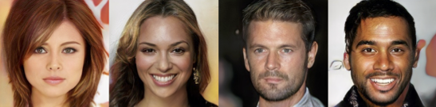
Generative Adversarial Networks
Generative adversarial networks (GANs) are an exciting recent innovation in machine learning.
GANs are generative models: they create new data instances that resemble your training data.
For example, GANs can create images that look like photographs of human faces, even though the faces don't belong to any real person.
These images were created by a GAN:
Figure 1: Images generated by a GAN created by NVIDIA.

Slide 3
Generative Adversarial Networks
GANs achieve this level of realism by pairing a generator, which learns to produce the target output, with a discriminator, which learns to distinguish true data from the output of the generator.
The generator tries to fool the discriminator, and the discriminator tries to keep from being fooled.

Slide 4
Background: What is a Generative Model?
What does "generative" mean in the name "Generative Adversarial Network"? "Generative" describes a class of statistical models that contrasts with discriminative models.
Generative models can generate new data instances.
Discriminative models discriminate between different kinds of data instances.
A generative model could generate new photos of animals that look like real animals, while a discriminative model could tell a dog from a cat.
GANs are just one kind of generative model.
More formally, given a set of data instances X and a set of labels Y:
Generative models capture the joint probability p(X, Y), or just p(X) if there are no labels.
Discriminative models capture the conditional probability p(Y | X).
A generative model includes the distribution of the data itself, and tells you how likely a given example is.
For example, models that predict the next word in a sequence are typically generative models (usually much simpler than GANs) because they can assign a probability to a sequence of words.
A discriminative model ignores the question of whether a given instance is likely, and just tells you how likely a label is to apply to the instance.

Slide 5
Generative Models Are Hard
Generative models tackle a more difficult task than analogous discriminative models. Generative models have to model more.
A generative model for images might capture correlations like "things that look like boats are probably going to appear near things that look like water" and "eyes are unlikely to appear on foreheads." These are very complicated distributions.
In contrast, a discriminative model might learn the difference between "sailboat" or "not sailboat" by just looking for a few tell-tale patterns. It could ignore many of the correlations that the generative model must get right.
Discriminative models try to draw boundaries in the data space, while generative models try to model how data is placed throughout the space. For example, the following diagram shows discriminative and generative models of handwritten digits:

Slide 6
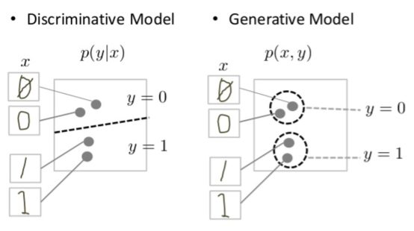
Discriminative and generative models of handwritten digits.
The discriminative model tries to tell the difference between handwritten 0's and 1's by drawing a line in the data space.
If it gets the line right, it can distinguish 0's from 1's without ever having to model exactly where the instances are placed in the data space on either side of the line.
In contrast, the generative model tries to produce convincing 1's and 0's by generating digits that fall close to their real counterparts in the data space.

Slide 7
Generative vs Discriminative model -Example
A father has two kids, Kid A and Kid B. Kid A has a special character whereas he can learn everything in depth. Kid B have a special character whereas he can only learn the differences between what he saw.
One fine day, The father takes two of his kids (Kid A and Kid B) to a zoo. This zoo is a very small one and has only two kinds of animals say a lion and an elephant. After they came out of the zoo, the father showed them an animal and asked both of them “is this animal a lion or an elephant?”
The Kid A, the kid suddenly draw the image of lion and elephant in a piece of paper based on what he saw inside the zoo. He compared both the images with the animal standing before and answered based on the closest match of image & animal, he answered: “The animal is Lion”.
The Kid B knows only the differences, based on different properties learned, he answered: “The animal is a Lion”.
Here, we can see both of them is finding the kind of animal, but the way of learning and the way of finding answer is entirely different. In Machine Learning, We generally call Kid A as a Generative Model & Kid B as a Discriminative Model.
In General, A Discriminative model ‌models the decision boundary between the classes.
A Generative Model ‌explicitly models the actual distribution of each class. In final both of them is predicting the conditional probability P(Animal | Features). But Both models learn different probabilities.
A Generative Model ‌learns the joint probability distribution p(x,y). It predicts the conditional probability with the help of Bayes Theorem.
A Discriminative model ‌learns the conditional probability distribution p(y|x). Both of these models were generally used in supervised learning problems.

Slide 8
Generative Models
Discriminative models are those used for most supervised classification or regression problems.
As an example of a classification problem, suppose you’d like to train a model to classify images of handwritten digits from 0 to 9.
For that, you could use a labeled dataset containing images of handwritten digits and their associated labels indicating which digit each image represents.
During the training process, you’d use an algorithm to adjust the model’s parameters. The goal would be to minimize a loss function so that the model learns the probability distribution of the output given the input.
After the training phase, you could use the model to classify a new handwritten digit image by estimating the most probable digit the input corresponds to, as illustrated in the figure below:
You can picture discriminative models for classification problems as blocks that use the training data to learn the boundaries between classes.
They then use these boundaries to discriminate an input and predict its class. In mathematical terms, discriminative models learn the conditional probability P(y|x) of the output y given the input x.

Slide 9
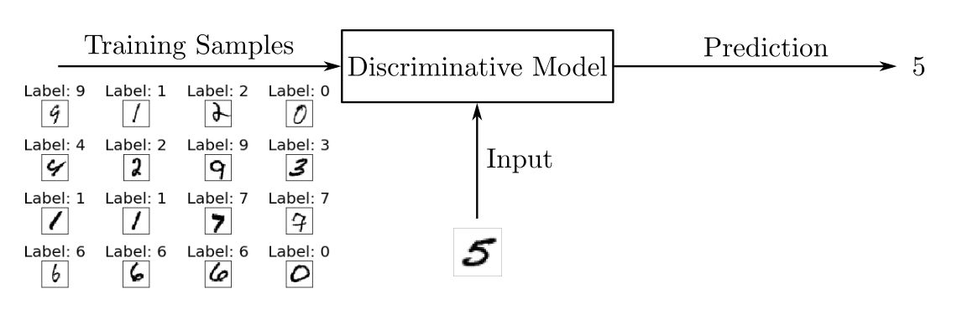
Discriminative models

Slide 10
Generative models
Generative models like GANs, however, are trained to describe how a dataset is generated in terms of a probabilistic model.
By sampling from a generative model, you’re able to generate new data.
Generative models are often used with unlabeled datasets and can be seen as a form of unsupervised learning.
Using the dataset of handwritten digits, you could train a generative model to generate new digits.
During the training phase, you’d use some algorithm to adjust the model’s parameters to minimize a loss function and learn the probability distribution of the training set.
Then, with the model trained, you could generate new samples, as illustrated in the following figure:
The random samples used to drive the generator are obtained from a latent space in which the vectors represent a kind of compressed form of the generated samples.
Unlike discriminative models, generative models learn the probability P(x) of the input data x, and by having the distribution of the input data, they’re able to generate new data instances.

Slide 11
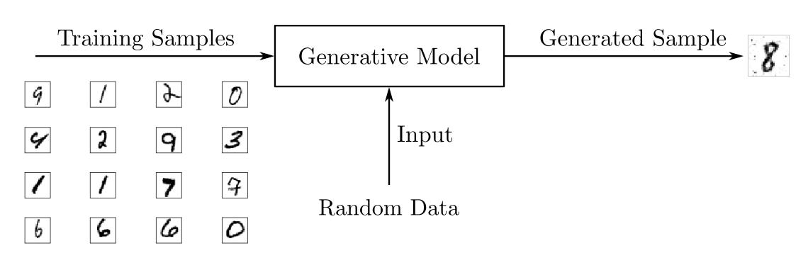
Generative models

Slide 12
Overview of GAN Structure
A generative adversarial network (GAN) has two parts:
The generator learns to generate plausible data. The generated instances become negative training examples for the discriminator.
The discriminator learns to distinguish the generator's fake data from real data. The discriminator penalizes the generator for producing implausible results.
When training begins, the generator produces obviously fake data, and the discriminator quickly learns to tell that it's fake:
Finally, if generator training goes well, the discriminator gets worse at telling the difference between real and fake.
It starts to classify fake data as real, and its accuracy decreases.

Slide 13
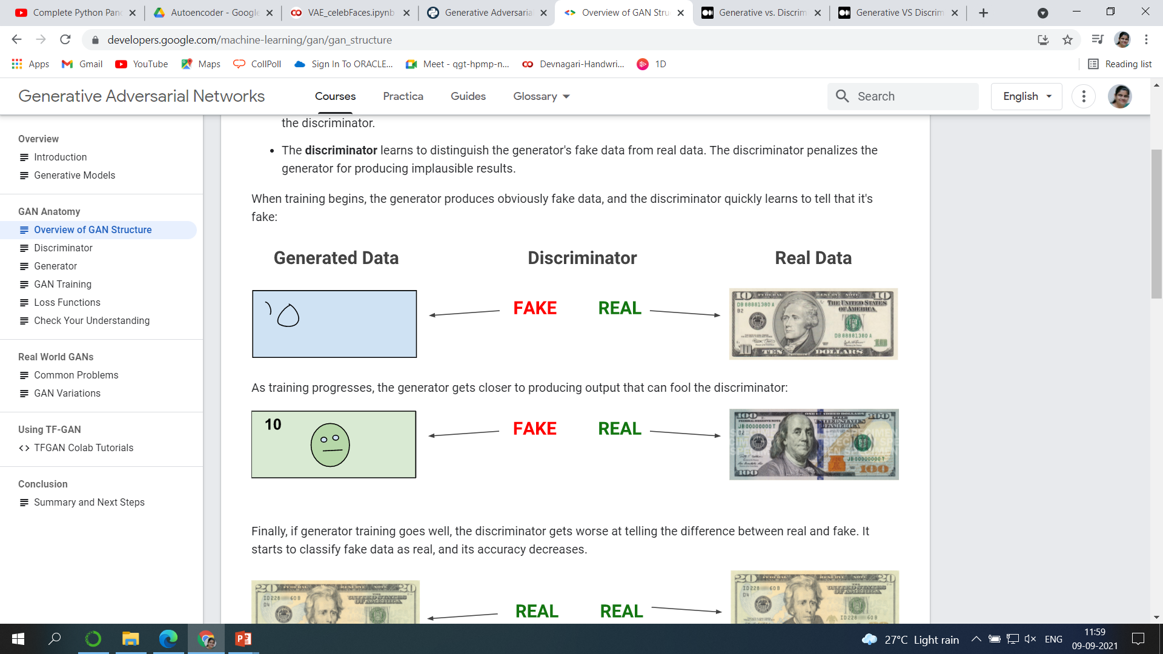
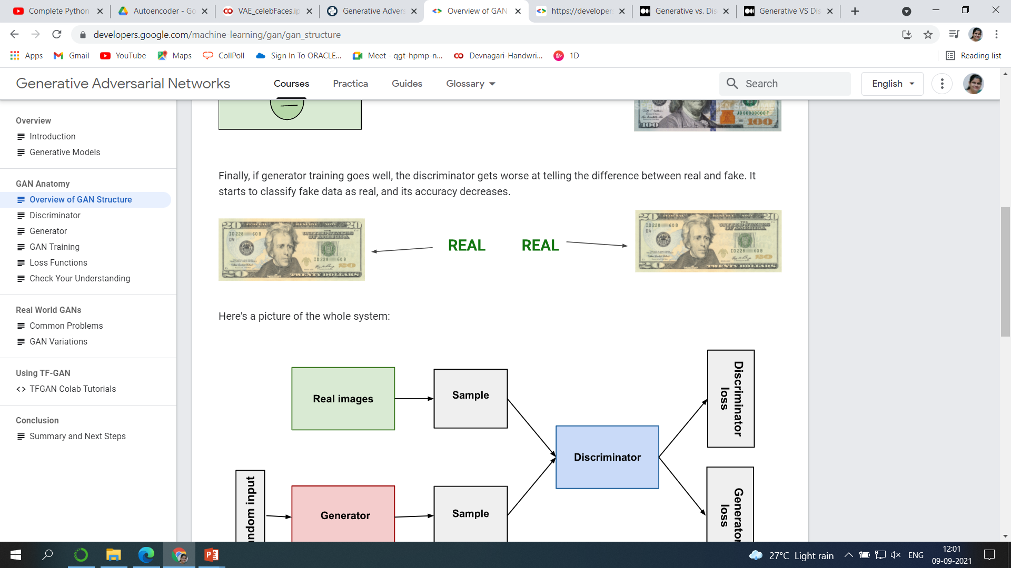
Overview of GAN Structure

Slide 14
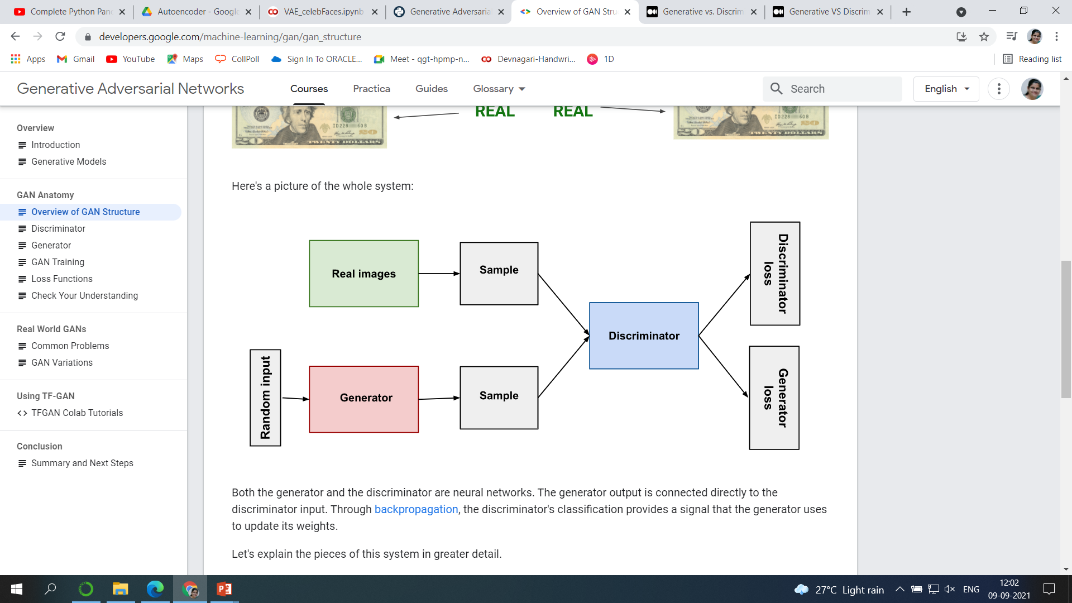
GAN System
Both the generator and the discriminator are neural networks.
The generator output is connected directly to the discriminator input.
Through back propagation, the discriminator's classification provides a signal that the generator uses to update its weights.

Slide 15
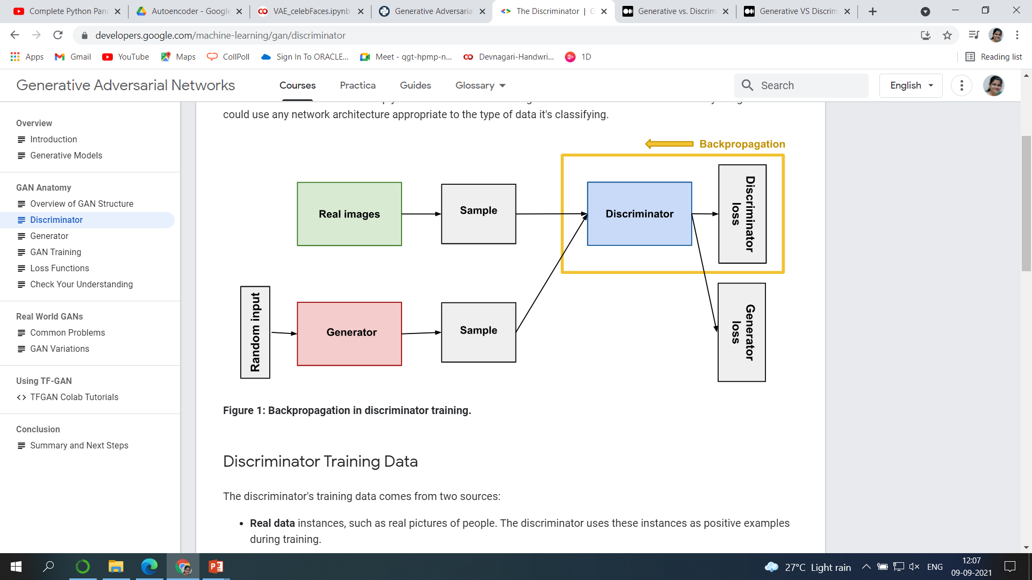
The Discriminator
The discriminator in a GAN is simply a classifier.
It tries to distinguish real data from the data created by the generator.
It could use any network architecture appropriate to the type of data it's classifying.

Slide 16
Discriminator Training Data
The discriminator's training data comes from two sources:
Real data instances, such as real pictures of people. The discriminator uses these instances as positive examples during training.
Fake data instances created by the generator. The discriminator uses these instances as negative examples during training.
In Figure 1, the two "Sample" boxes represent these two data sources feeding into the discriminator.
During discriminator training the generator does not train. Its weights remain constant while it produces examples for the discriminator to train on.

Slide 17
Training the Discriminator
The discriminator connects to two loss functions.
During discriminator training, the discriminator ignores the generator loss and just uses the discriminator loss.
During discriminator training:
The discriminator classifies both real data and fake data from the generator.
The discriminator loss penalizes the discriminator for misclassifying a real instance as fake or a fake instance as real.
The discriminator updates its weights through backpropagation from the discriminator loss through the discriminator network.

Slide 18
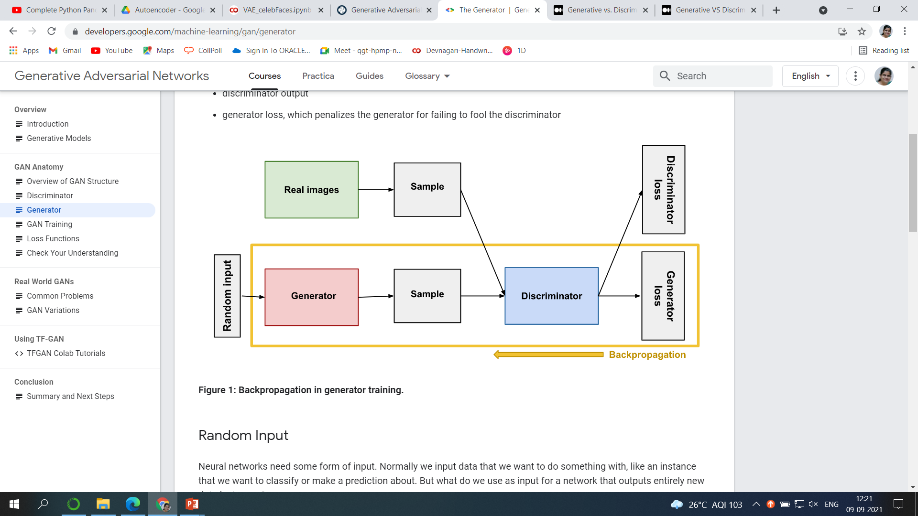
The Generator
The generator part of a GAN learns to create fake data by incorporating feedback from the discriminator.
It learns to make the discriminator classify its output as real.
Generator training requires tighter integration between the generator and the discriminator than discriminator training requires.
The portion of the GAN that trains the generator includes:
random input
generator network, which transforms the random input into a data instance
discriminator network, which classifies the generated data
discriminator output
generator loss, which penalizes the generator for failing to fool the discriminator

Slide 19
Random Input to Generator
Neural networks need some form of input.
Normally we input data that we want to do something with, like an instance that we want to classify or make a prediction about.
But what do we use as input for a network that outputs entirely new data instances?
In its most basic form, a GAN takes random noise as its input.
The generator then transforms this noise into a meaningful output.
By introducing noise, we can get the GAN to produce a wide variety of data, sampling from different places in the target distribution.
Experiments suggest that the distribution of the noise doesn't matter much, so we can choose something that's easy to sample from, like a uniform distribution.
For convenience the space from which the noise is sampled is usually of smaller dimension than the dimensionality of the output space.

Slide 20
Using the Discriminator to Train the Generator
To train a neural net, we alter the net's weights to reduce the error or loss of its output. In our GAN, however, the generator is not directly connected to the loss that we're trying to affect.
The generator feeds into the discriminator net, and the discriminator produces the output we're trying to affect. The generator loss penalizes the generator for producing a sample that the discriminator network classifies as fake.
This extra chunk of network must be included in backpropagation.
Backpropagation adjusts each weight in the right direction by calculating the weight's impact on the output — how the output would change if you changed the weight. But the impact of a generator weight depends on the impact of the discriminator weights it feeds into. So backpropagation starts at the output and flows back through the discriminator into the generator.
At the same time, we don't want the discriminator to change during generator training. Trying to hit a moving target would make a hard problem even harder for the generator.
So we train the generator with the following procedure:
Sample random noise.
Produce generator output from sampled random noise.
Get discriminator "Real" or "Fake" classification for generator output.
Calculate loss from discriminator classification.
Backpropagate through both the discriminator and generator to obtain gradients.
Use gradients to change only the generator weights.
This is one iteration of generator training.

Slide 21
GAN Training
Because a GAN contains two separately trained networks, its training algorithm must address two complications:
GANs must juggle two different kinds of training (generator and discriminator).
GAN convergence is hard to identify.
Alternating Training
The generator and the discriminator have different training processes. So how do we train the GAN as a whole?
GAN training proceeds in alternating periods:
The discriminator trains for one or more epochs.
The generator trains for one or more epochs.
Repeat steps 1 and 2 to continue to train the generator and discriminator networks.
We keep the generator constant during the discriminator training phase. As discriminator training tries to figure out how to distinguish real data from fake, it has to learn how to recognize the generator's flaws. That's a different problem for a thoroughly trained generator than it is for an untrained generator that produces random output.
Similarly, we keep the discriminator constant during the generator training phase. Otherwise the generator would be trying to hit a moving target and might never converge.
It's this back and forth that allows GANs to tackle otherwise intractable generative problems. We get a toehold in the difficult generative problem by starting with a much simpler classification problem. Conversely, if you can't train a classifier to tell the difference between real and generated data even for the initial random generator output, you can't get the GAN training started.

Slide 22
Convergence
As the generator improves with training, the discriminator performance gets worse because the discriminator can't easily tell the difference between real and fake.
If the generator succeeds perfectly, then the discriminator has a 50% accuracy. In effect, the discriminator flips a coin to make its prediction.
This progression poses a problem for convergence of the GAN as a whole: the discriminator feedback gets less meaningful over time.
If the GAN continues training past the point when the discriminator is giving completely random feedback, then the generator starts to train on junk feedback, and its own quality may collapse.
For a GAN, convergence is often a fleeting, rather than stable, state.

Slide 23
How to build a GAN using an analogy
The classic analogy is the counterfeiter (generator) and FBI agent (discriminator). The counterfeiter is constantly looking for new ways to produce fake documents that can pass the FBI agent’s tests. Let’s break it down into a set of goals:
Counterfeiter (generator) goal: Produce products so that the cop cannot distinguish between the real and fake ones
Cop (discriminator) goal: Detect anomalous products by using prior experience to classify real and fake products

